Slide 1
Multi-Label Emotion Classification of Tweets Using Machine Learning
Course No : CSE-400
Course Title: Project & Thesis
Supervised By
Animesh Chandra Roy
Assistant Professor
Dept. of CSE, CUET
Presented By
Simon Islam
ID No : 1504062

Slide 2
Outline
Introduction
Motivation
Related Work
Research Challenges
Contributions
System Architecture
Methodology
Experimental Results
Conclusion
References

Slide 3
Introduction
Emotion Detection
Process of identifying emotions from texts
Provides valuable information to human psyche
Information gathered can be used later for developing conscious programs
Emotions considered in this work: Joy, Sadness, Anger, Disgust, Admiration, Surprise, Interest, Fear

Slide 4
Introduction (Cont.)
Multi-label Classification
Multiple labels assigned to each instance
Classes aren’t mutually exclusive
Has no constraint on class assignment
Example: @tommcfly hope u enjoy the movie! AND have fun tomorrow I don't think I'm gonna make it to your show
Emotions Present: Joy, Sadness.

Slide 5

Introduction (Cont.)
Why Twitter?
Has 330 million monthly active users¹
Has 145 million daily active users¹
83% of the world’s leaders are on Twitter²
Reach is not limited
Can determine current trends based on tweets
https://s22.q4cdn.com/826641620/files/doc_financials/2019/q1/Q1-2019-Selected-Company-Metrics-and-Financials.pdf
https://www.prnewswire.com/news-releases/world-leaders-on-twitter--adoption-stagnates-even-as-follower-base-explodes-300208802.html

Slide 6
Motivation
Labelling posts as positive or negative are not enough
To have a dataset of properly labeled tweets with appropriate emotions
Training a model to perform multi-label emotion classification

Slide 7
Related Works
S. M. Liu and J.-H. Chen, “A multi-label classification based approach for sentiment classification,” Expert Systems with Applications, vol. 42, no. 3, pp. 1083–1093, Feb. 2015. [1]
Used various classification methods to perform multi-label classification
Used 3 different sentiment dictionaries
8 state of the art multi-label classification methods were evaluated
Limitations:
Only used text segmentation, didn’t consider other aspects like punctuations, hashtags etc.
Datasets limited to tweets concerning two incidents

Slide 8
Related Works (Cont.)
M. Bouazizi and T. Ohtsuki, “Multi-class sentiment analysis on twitter: Classification performance and challenges,” Big Data Mining and Analytics, vol. 2, no. 3, pp. 181–194, Sep. 2019. [2]
Proposed a multi-class classification approach
Used 7 sentiment classes to label 2 datasets
Used their software called SENTA to extract features and classification
Limitations:
Does not recognize multiple emotions in a tweet
Used 3 pairs of opposite emotions

Slide 9
Related Works (Cont.)
L. A. Cabrera-Diego, N. Bessis, and I. Korkontzelos, “Classifying emotions in Stack Overflow and JIRA using a multi-label approach,” Knowledge-Based Syst., vol. 195, p. 105633, 2020 [3]
Used issue tracker comments on Stackoverflow & JIRA
Used two multi-label classifiers to classify the posts
Limitations:
Dataset only focused on issues posted in stackoverflow and JIRA
Only used two problem transformation methods (RAkEL & HOMER) for multi-label classifications

Slide 10
Research Challenges
Challenges
Lack of Datasets
Bias in Training Data
Scope of the Work
Exponential Complexity
Applications
Classifying emotions in social media feeds
Classifying emotions in brand reviews
Prioritize job assignments based on emotions

Slide 11
Contributions
Development of a tweet dataset with properly labelled emotions
Training various multi label classification models with the features extracted from the dataset
Using Senticnet5 to improve the accuracy of the models

Slide 12
System Architecture

Slide 13
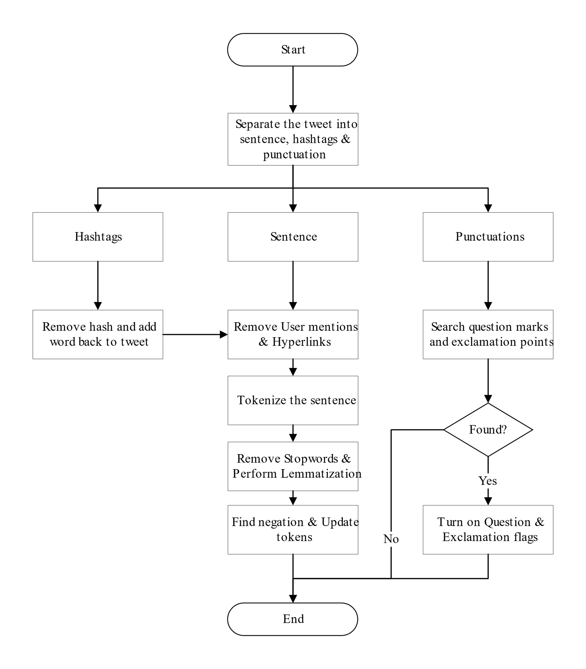
Methodology
Figure. Tweet Preprocessing

Slide 14
Methodology (Cont.)
Process | Example
Raw tweet | @alamin I did not have a good day but @refat had a blast. #Mixed #day Watch it here: https://youtu.be/dQw4w9WgXcQ
Remove User mention | i did not have a good day but had a blast. #mixed #day watch it here: https://youtu.be/dqw4w9wgxcq
Remove Hyperlinks | i did not have a good day but had a blast. #mixed #day watch it here:
Process Hashtags | i did not have a good day but had a blast mixed day watch it here
Tokenization & Remove stopwords | ['i', 'did', 'not', 'have', 'good', 'day', 'had', 'blast', 'mixed', 'day', 'watch', 'here']
Lemmatization | ['i', 'do', 'not', 'have', 'a', 'good', 'day', 'but', 'have', 'a', 'blast', 'mixed', 'day', 'watch', 'it', 'here']
Negation Words | ['have', 'a', 'good', 'day']
POS tagging | [('i', 'NN'), ('did', 'VBD'), ('not', 'RB'), ('have', 'VB'), ('a', 'DT'), ('good', 'JJ'), ('day', 'NN'), ('but', 'CC'), ('had', 'VBD'), ('a', 'DT'), ('blast', 'NN'), ('mixed', 'JJ'), ('day', 'NN'), ('watch', 'VB'), ('it', 'PRP'), ('here', 'RB')]
Post POS tagging | ['i', 'did', 'not', 'have', 'good', 'day', 'had', 'blast', 'mixed', 'day', 'watch', 'here']
Final Output | i do not have good day have blast mixed day watch here
Table 1. Tweet Preprocessing Steps

Slide 15
Methodology (Cont.)
Senticnet5 [4]
Began in MIT Media Laboratory in 2009
Used as an enhancement during the training phase
Tf-idf Vectorizer
Stands for term frequency-inverse document frequency
Represents relevancy of each word
Used for converting the dataset into matrix representation

Slide 16
Methodology (Cont.)
Training Multi-Label Emotion Classifiers
Problem Transformation Methods
Transform multi-label problem into multiple binary classifications & multi-class classification problem
Base classifiers are needed to train models (Ex. RFC, SVM)
Example: Binary Relevance, Label Powerset etc.
Algorithm Adaption Methods
Adapts well known algorithms to work with multiple labels
Example: MLkNN, BRkNN etc.

Slide 17
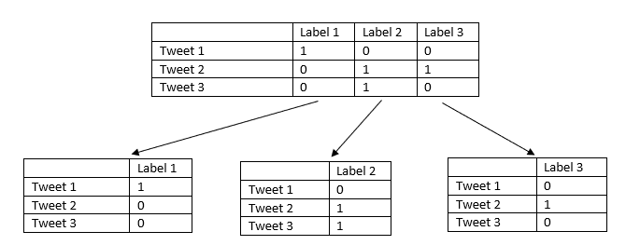
Methodology (Cont.)
Binary Relevance (BR) [5]
Transform the problem into n binary classification problem
Each models trained separately
Models are independent and can be used in other works

Slide 18
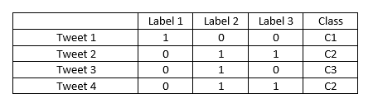
Methodology (Cont.)
Label Powerset (LP) [6]
Transforms the problem into multi-class classification problem
Classes were assigned according to unique label combinations
Correct class prediction leads to correct prediction for all emotions

Slide 19
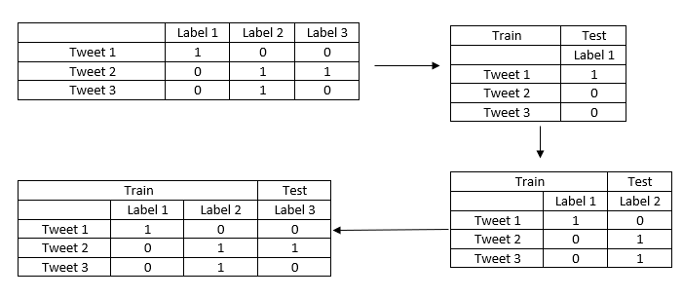
Methodology (Cont.)
Classifier Chains (CC) [7]
Trains the models sequentially
Efficiency depends on the order of the chain
Maintains correlation between different labels

Slide 20
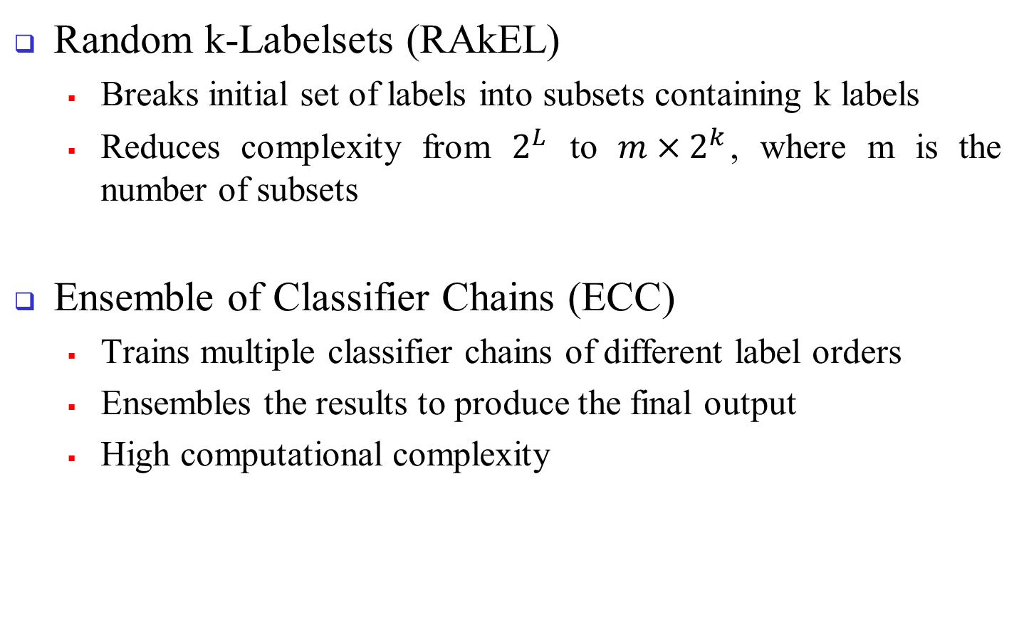
Methodology (Cont.)
Random k-Labelsets (RAkEL)
Breaks initial set of labels into subsets containing k labels
Reduces complexity from $2^{L}$ to $m×2^{k}$, where m is the number of subsets
Ensemble of Classifier Chains (ECC)
Trains multiple classifier chains of different label orders
Ensembles the results to produce the final output
High computational complexity

Slide 21
Methodology (Cont.)
MLkNN [8]
Adapts K nearest neighbor algorithm to work with multiple labels
Uses Maximum a posteriori (MAP) principal to determine labels for unidentified data
MAP is based on the information from nearest neighbors

Slide 22
Methodology (Cont.)
BRkNN [9]
Combines approaches from binary relevance and k nearest neighbors
Has two extensions BRkNN-a & BRkNN-b
BRkNN-a outputs labels present in half of the nearest neighbors
BRkNN-b outputs first k labels with highest confidence value, where k is label density rounded to nearest integer

Slide 23
Experimental Results
Dataset Description
Tweets selected from Sentiment140 dataset
Tweets were labeled according to emotions (Joy, Sadness, Anger, Disgust, Admiration, Surprise, Interest, Fear)
Total number of tweets 8501
Label Cardinality 1.5
Label Density 0.1875

Slide 24
Experimental Results (Cont.)
Text | Joy | Sadness | Anger | Disgust | Admiration | Surprise | Interest | Fear
So much for sleeping in. | 0 | 1 | 0 | 0 | 0 | 0 | 0 | 0
College days are loooong days.. 3 more hours #tired | 0 | 1 | 0 | 0 | 0 | 0 | 1 | 0
@daihard I'm headed to Kentucky this time. Never been so it should be fun! ? http://blip.fm/~5gqz1 | 0 | 0 | 0 | 0 | 0 | 0 | 1 | 0
hella tired.. where is gilbert for the usual basketball talk?! | 0 | 0 | 1 | 0 | 0 | 0 | 1 | 0
Not as dry this morning as would have liked lot of moisture on the dune grass this am meant me and the dogs came home soaking wet! | 0 | 1 | 0 | 1 | 0 | 0 | 0 | 0
@lil_laura_loo Really? I think we have some! I've taken Piriteeze but only works for a little while and can only take 1 a day! xo | 0 | 0 | 0 | 0 | 0 | 1 | 0 | 1
Table 2. Sample of the dataset

Slide 25
Experimental Results (Cont.)
Emotion | No. of Tweets
Joy | 2406
Sadness | 4126
Anger | 989
Disgust | 1380
Admiration | 578
Surprise | 624
Interest | 2134
Fear | 674
Table 3. Emotion Distribution in the dataset

Slide 26
Experimental Results (Cont.)

Slide 27
Experimental Results (Cont.)
Association Rules | Support | Confidence | Lift
Admiration -> Joy | 0.089 | 0.682 | 1.904
Disgust -> Anger | 0.087 | 0.394 | 1.252
Disgust -> Sadness | 0.231 | 0.732 | 1.277
Joy -> Interest | 0.161 | 0.464 | 1.296
Joy -> Surprise | 0.046 | 0.131 | 1.005
Admiration, Interest -> Anger | 0.0017 | 0.005 | 1.188
Admiration, Joy -> Interest | 0.011 | 0.029 | 1.028
Admiration, Sadness, Interest -> Anger | 0.0002 | 1 | 2.792
Table 4. Association Rules generated from the Dataset

Slide 28
Experimental Results (Cont.)
Evaluation Metrics
Hamming Loss
0/1 Subset Loss
Macro F-Score
Micro F-Score
Average Accuracy

Slide 29
Experimental Results (Cont.)
Evaluation Metric | BR |  | LP |  | CC |  | RAkEL |  | ECC |  | MLkNN | BRkNN
 | RFC | SVM | RFC | SVM | RFC | SVM | RFC | SVM | RFC | SVM |  | a | b
Hamming Loss | 0.164 | 0.162 | 0.172 | 0.18 | 0.163 | 0.175 | 0.168 | 0.167 | 0.165 | 0.174 | 0.166 | 0.172 | 0.284
0/1 Subset Loss | 0.192 | 0.197 | 0.272 | 0.253 | 0.23 | 0.261 | 0.24 | 0.228 | 0.227 | 0.247 | 0.207 | 0.183 | 0.063
Macro F-Score | 0.892 | 0.893 | 0.865 | 0.84 | 0.888 | 0.866 | 0.878 | 0.875 | 0.885 | 0.86 | 0.888 | 0.883 | 0.79
Mircro F-Score | 0.905 | 0.906 | 0.897 | 0.893 | 0.904 | 0.895 | 0.9 | 0.901 | 0.903 | 0.896 | 0.902 | 0.901 | 0.822
Average Accuracy | 0.835 | 0.837 | 0.827 | 0.819 | 0.836 | 0.824 | 0.831 | 0.832 | 0.834 | 0.825 | 0.833 | 0.827 | 0.715
Table 5. Evaluation of the models without Preprocessing

Slide 30
Experimental Results (Cont.)
Evaluation Metric | BR |  | LP |  | CC |  | RAkEL |  | ECC |  | MLkNN | BRkNN
 | RFC | SVM | RFC | SVM | RFC | SVM | RFC | SVM | RFC | SVM |  | a | b
Hamming Loss | 0.16 | 0.161 | 0.169 | 0.172 | 0.162 | 0.17 | 0.165 | 0.167 | 0.162 | 0.171 | 0.169 | 0.17 | 0.255
0/1 Subset Loss | 0.223 | 0.213 | 0.277 | 0.278 | 0.263 | 0.281 | 0.249 | 0.262 | 0.26 | 0.265 | 0.202 | 0.169 | 0.094
Macro F-Score | 0.895 | 0.894 | 0.877 | 0.867 | 0.888 | 0.875 | 0.884 | 0.875 | 0.885 | 0.869 | 0.887 | 0.891 | 0.821
Mircro F-Score | 0.907 | 0.906 | 0.899 | 0.897 | 0.904 | 0.898 | 0.903 | 0.901 | 0.904 | 0.897 | 0.901 | 0.902 | 0.843
Average Accuracy | 0.839 | 0.838 | 0.83 | 0.827 | 0.837 | 0.829 | 0.835 | 0.832 | 0.837 | 0.828 | 0.83 | 0.829 | 0.744
Table 6. Evaluation of the models with Preprocessing

Slide 31
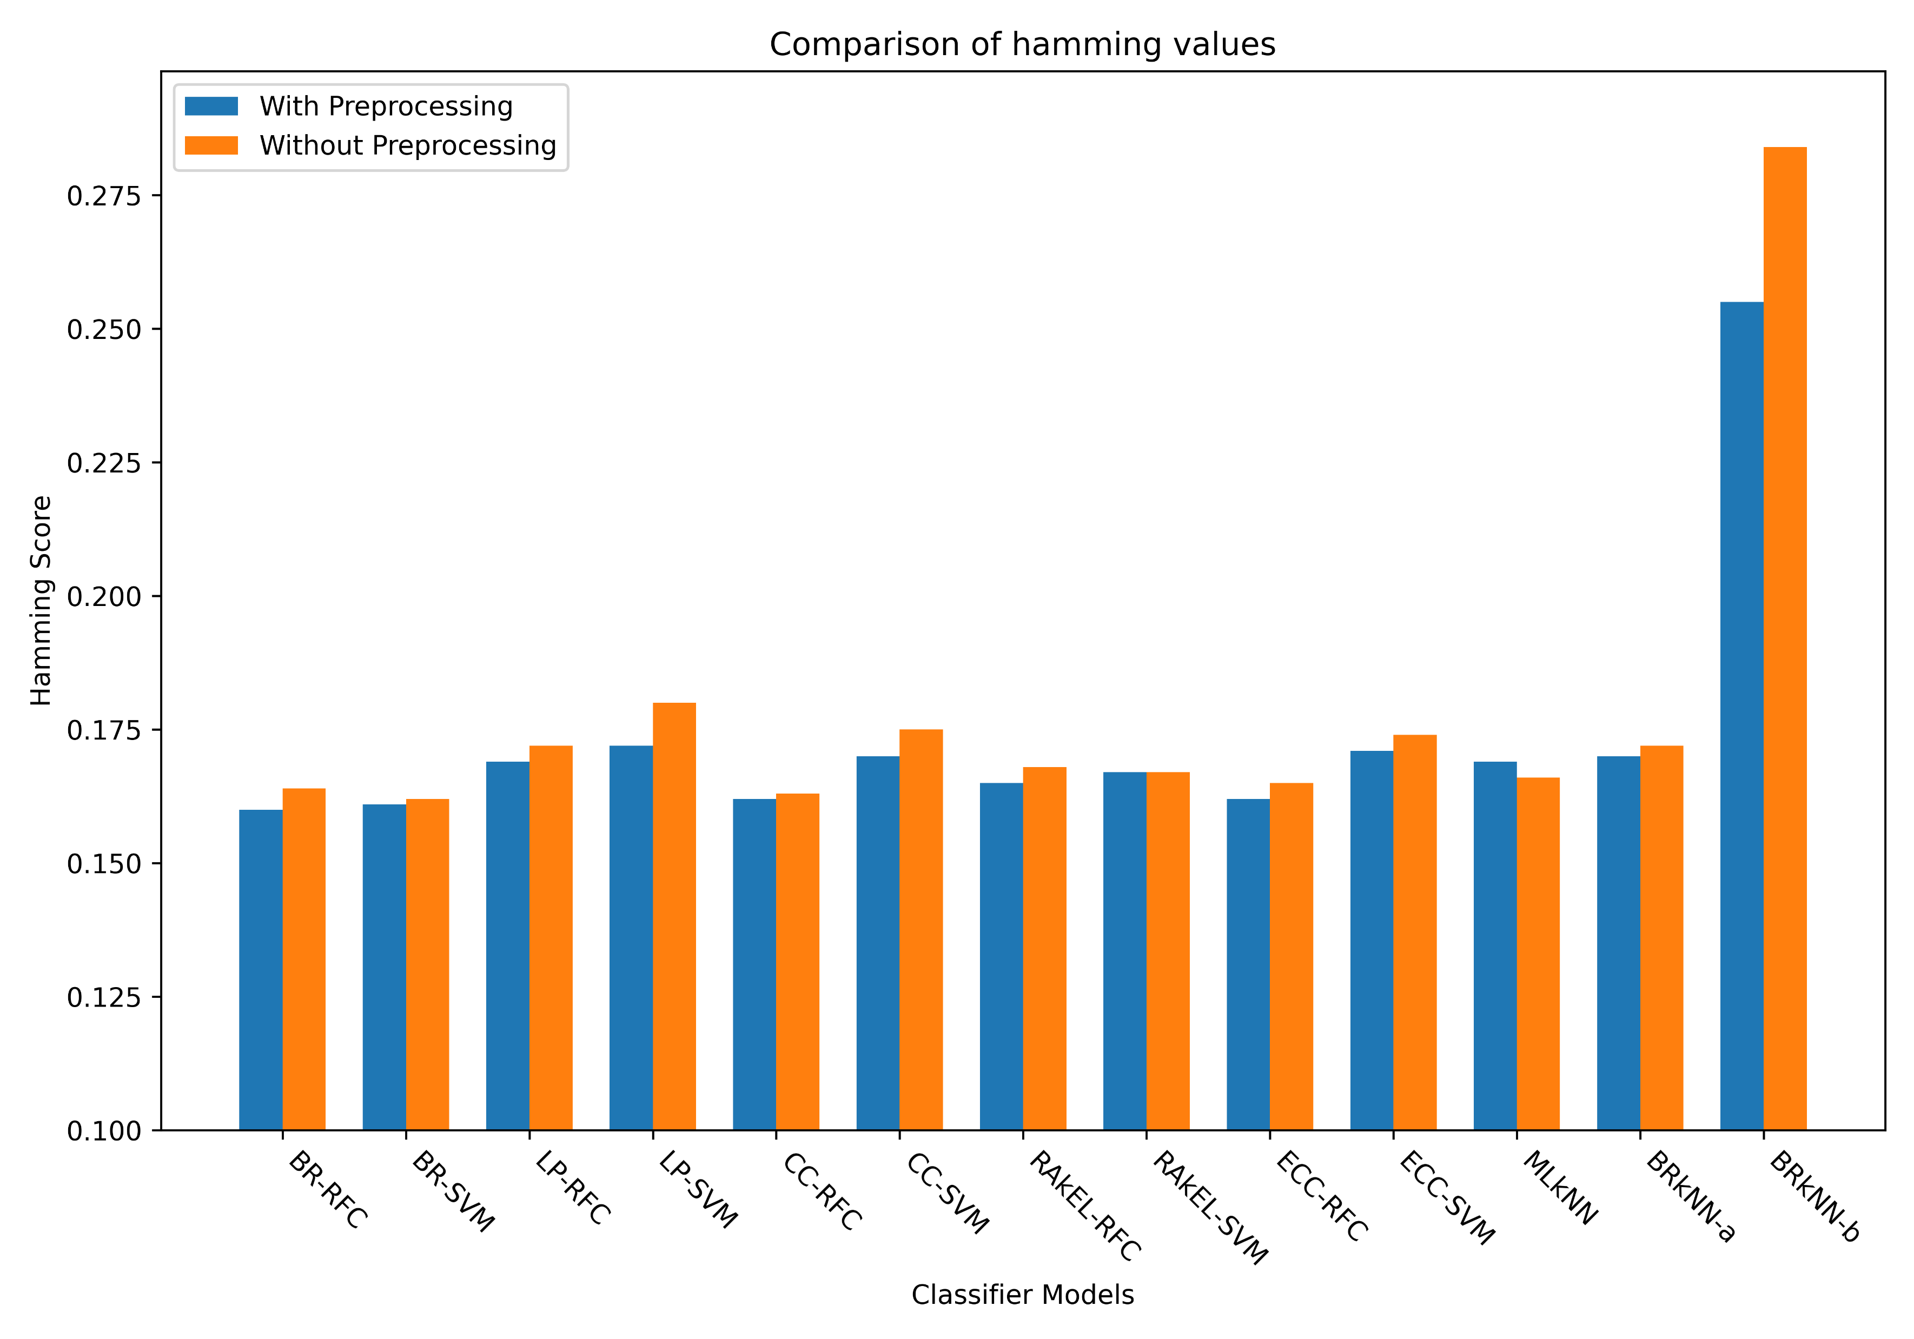
Experimental Results (Cont.)
Figure. Comparison of Hamming Loss

Slide 32
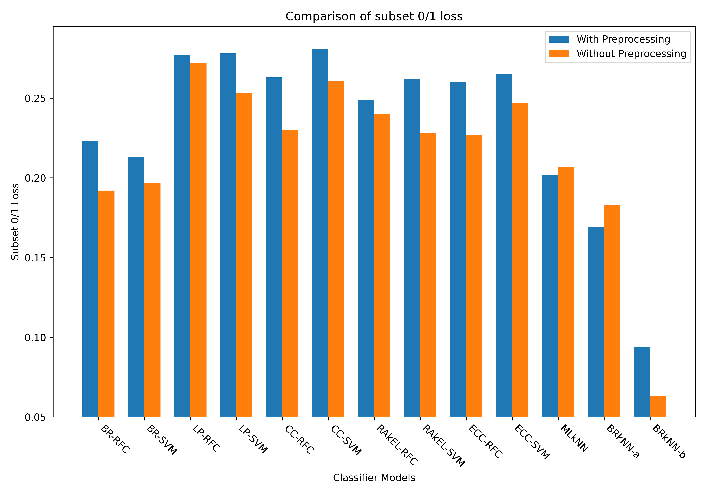
Experimental Results (Cont.)
Figure. Comparison of 0/1 Subset Loss

Slide 33
Conclusion
Can classify tweets in multiple labels
Lowest hamming loss achieved is 0.16 by binary relevance with random forest classifier as base classifier
Highest subset 0/1 loss achieved is 0.278 using label powerset with SVM as base classifier
Inclusion of Senticnet5 improved the models

Slide 34
Conclusion (Cont.)
Future Improvements
More emotions can be considered in the future
More raters to evaluate the validity of the dataset
Increasing the size of the dataset
Training & evaluating using other methods not mentioned in this work

Slide 35
References
[1] S. M. Liu and J.-H. Chen, “A multi-label classification based approach for sentiment classification,” Expert Syst. Appl., vol. 42, no. 3, pp. 1083–1093, 2015.
[2] M. Bouazizi and T. Ohtsuki, “Multi-class sentiment analysis on twitter: Classification performance and challenges,” Big Data Min. Anal., vol. 2, no. 3, pp. 181–194, 2019, doi: 10.26599/BDMA.2019.9020002.
[3] L. A. Cabrera-Diego, N. Bessis, and I. Korkontzelos, “Classifying emotions in Stack Overflow and JIRA using a multi-label approach,” Knowledge-Based Syst., vol. 195, p. 105633, 2020.
[4] E. Cambria, S. Poria, D. Hazarika, and K. Kwok, “SenticNet 5: Discovering conceptual primitives for sentiment analysis by means of context embeddings,” in Thirty-Second AAAI Conference on Artificial Intelligence, 2018.
[5] M. R. Boutell, J. Luo, X. Shen, and C. M. Brown, “Learning multi-label scene classification,” Pattern Recognit., vol. 37, no. 9, pp. 1757–1771, 2004.
[6] P. Szymański and T. Kajdanowicz, “A scikit-based Python environment for performing multi-label classification,” arXiv Prepr. arXiv1702.01460, 2017.

Slide 36
References (Cont.)
[7] J. Read, B. Pfahringer, G. Holmes, and E. Frank, “Classifier chains for multi-label classification,” Mach. Learn., vol. 85, no. 3, p. 333, 2011.
[8] M.-L. Zhang and Z.-H. Zhou, “ML-KNN: A lazy learning approach to multi-label learning,” Pattern Recognit., vol. 40, no. 7, pp. 2038–2048, 2007.
[9] I. V. Eleftherios Spyromitros Grigorios Tsoumakas, “An Empirical Study of Lazy Multilabel Classification Algorithms,” in Proc. 5th Hellenic Conference on Artificial Intelligence (SETN 2008), 2008.

Slide 37
Thank You

